Slide 1
Group 1 / Name of App
GEOG 4043 GEOVIS

Slide 2

Overview
We plan to provide visuals that show bus stop frequency before and during the COVID-19 pandemic
The web map will allow the user to see the RTD bus frequency during the pandemic.
Our data set will start in 2018 going through to 2020.
The visual will include how the frequency of routes changed from 2018-2020 and its effect on socio-economic data.
Audience here is linked to anyone looking to make inferences about pandemic reactions to public transit (budget planners, users, business development groups etc)
Chip says…
Get started early

Slide 3
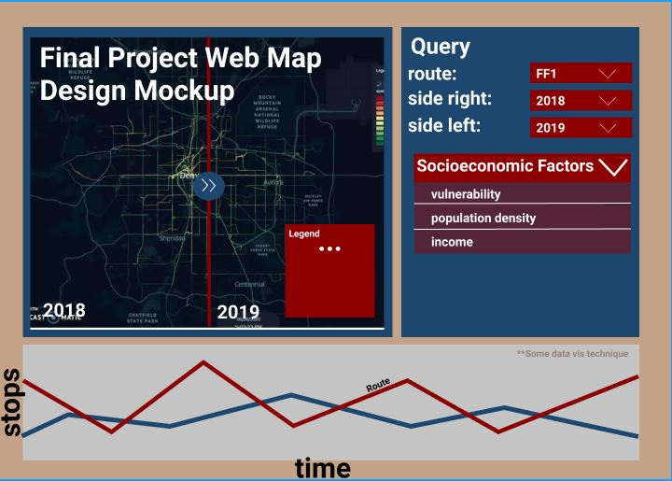
Design Mockup
5
Notes:
Lets pic k6 routes to compare - that way we limit the amount of data we are trying to present -- we can explain it as a proof oc concept idea - that scales
Income, bus stop frequency in each census tract - could come up with a number , how many buses stops at a certain location - not as much of an effect on route
how many stops did buses make in a time period ( 6 months for example)
socidemogrpahic - (worried) may not get us what we want
stream river chart - bus frequency - articles called -- visualising bus frequency on a scatter plot line
X axis and Y axis
commnet: RTD ridership data - allow user to query routes vus all routes on map -- interactive element so not overwhelming
Add variable - income /outcome on pus - perope per day perhaps
show lots of types of data - so bus stop, road, ect - can be overwhelming - looking more clsoey at stop data - as thats valuable to bus rider ship
how do we derive the routes from lat/long

Slide 4
What you plan to do and how…
Using a simple three-panel layout
Have the main map on the top left,
The query tool on the top right,
And on the bottom center, we will have a visualization of the data from the routes and their frequency,
In which you can easily pick certain routes and view them on the map
Our visualization technique for the data is to be determined,
There are numerous articles below that introduce different methods for visualizing public transportation data.
WORDS
WORDS

Slide 5
What the application domain/problem is
Determining ridership pre & during pandemic
By showing bus frequency along user selectable routes
users can select different routes and compare those routes across different times; to view CHANGE IN BUS FREQUENCY
By having the ability to select individual or aggregate routes across a few map versions, users can compare frequency. This ties into see if bus route frequency impacted various social economic areas
Chip says…
Public transport is important

Slide 6
FIN
JPG Original

